Slide 1





Backup_Battlers
Project
Database Management System II Lab
CSE - 4410
01
May 31, 2024

Slide 2




Project Title
-MeloDisc
02

Slide 3
Table Of Contents
Title of the project
List of team members
Project Overview
Tools and Technology
ERD
Features
Demonstration
03

Slide 4



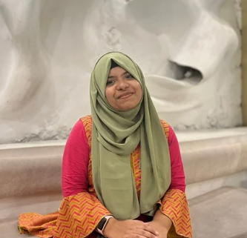
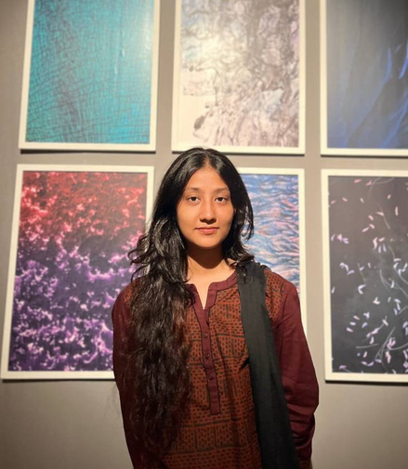
Our team
Nabila Islam
Nafisa Nawal Moumita
Faiza Maliat
210042111
210042130
210042163
04

Slide 5


Project Overview
A music database management platform that fosters an engaging environment where users can effortlessly discover, enjoy, and share their favorite music.
05

Slide 6







Programming Language:
C#
Data Storage:
Oracle SQL
Tools and Technology
User Interface:
.Net Framework
IDE:
Visual Studio
06

Slide 7
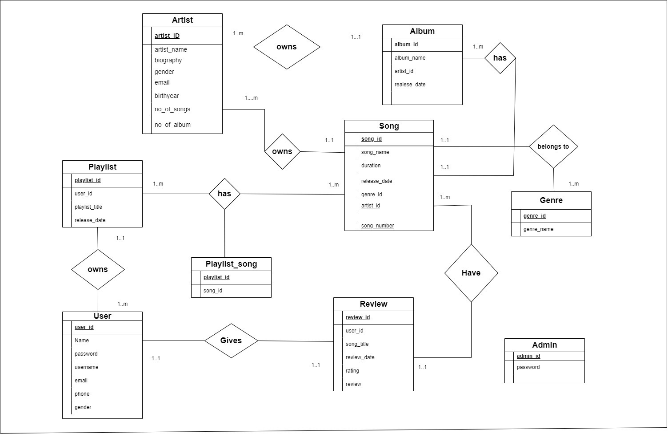
07

Slide 8

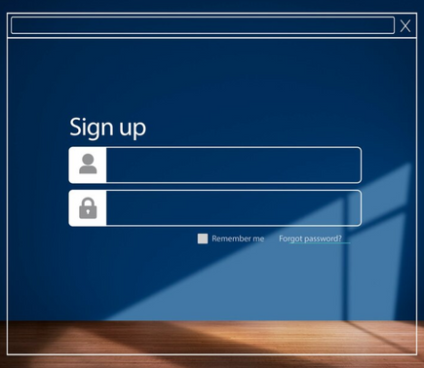



Features
Song Browsing and Searching
User Authentication and Account Management
Album Browsing and Searching
Admin Pannel
08

Slide 9




Features
Reviews and Ratings
Top N Lists
User-Created Playlists
Artist Profiles
09

Slide 10
THANK YOU
10

Slide 11


DEMONSTRATION
11

